Slide 1
Ranking of Vertices in Graphs HITS - Hyperlink Induced Topic Search
Link Analysis II

Slide 2
Query dependent score
- HITS - Kleinberg
Query independent score
- Pagerank – Larry Page and Sergey Brin
Notes:
sdfasdfasdfasd

Slide 3
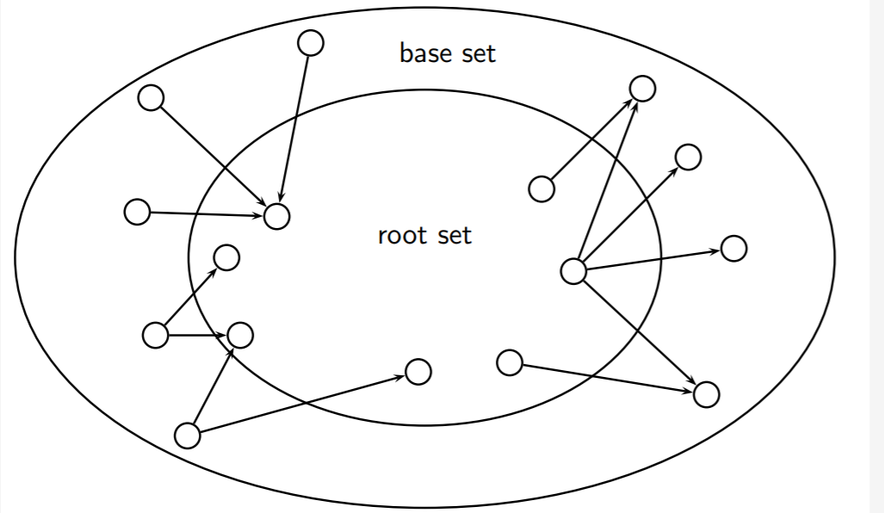
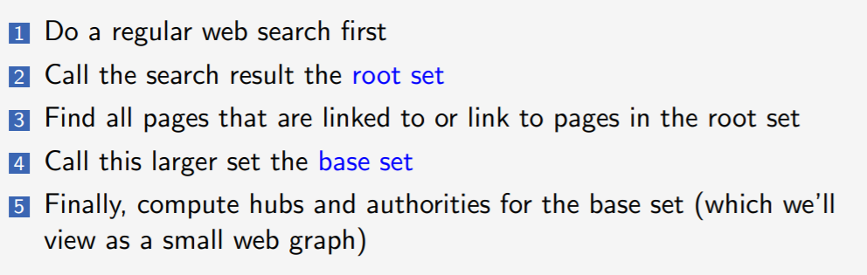
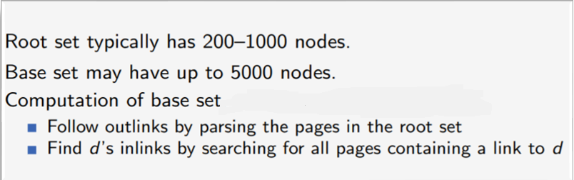
Base and Root set
d1
d2
d3
d4
.
.
dn
User
Query

Slide 4
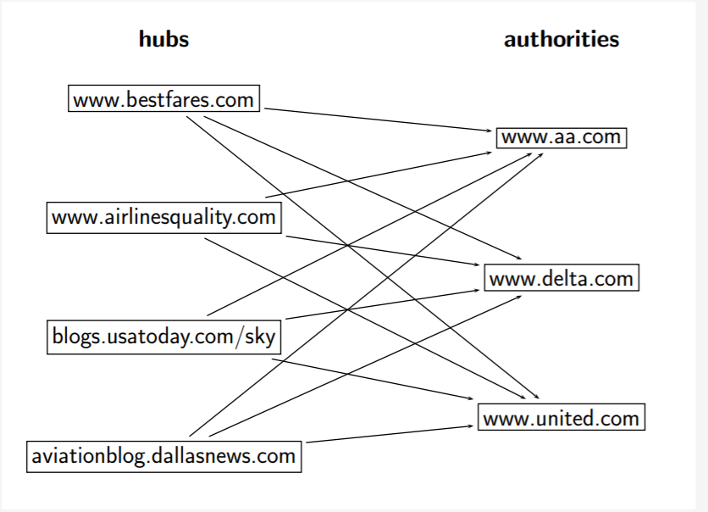
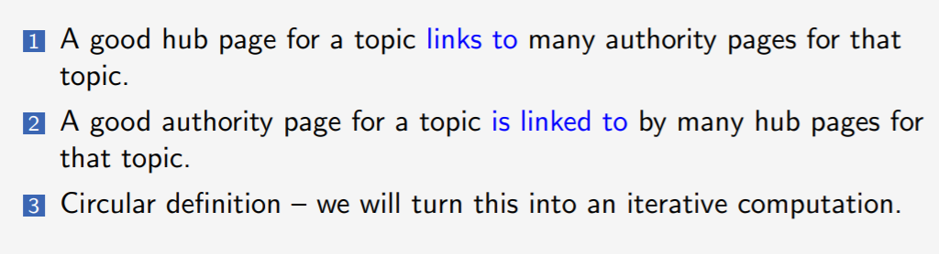
Hubs & Authorities
A good hub page is one that points to many good authorities
A good authority page is one that is pointed to by many good hub pages.

Slide 5
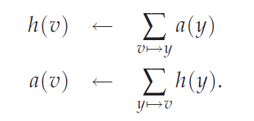
Hubs & Authorities
v:→ y the existence of a hyperlink from v to y.
y:→ v the existence of a hyperlink from y to v.

Slide 6
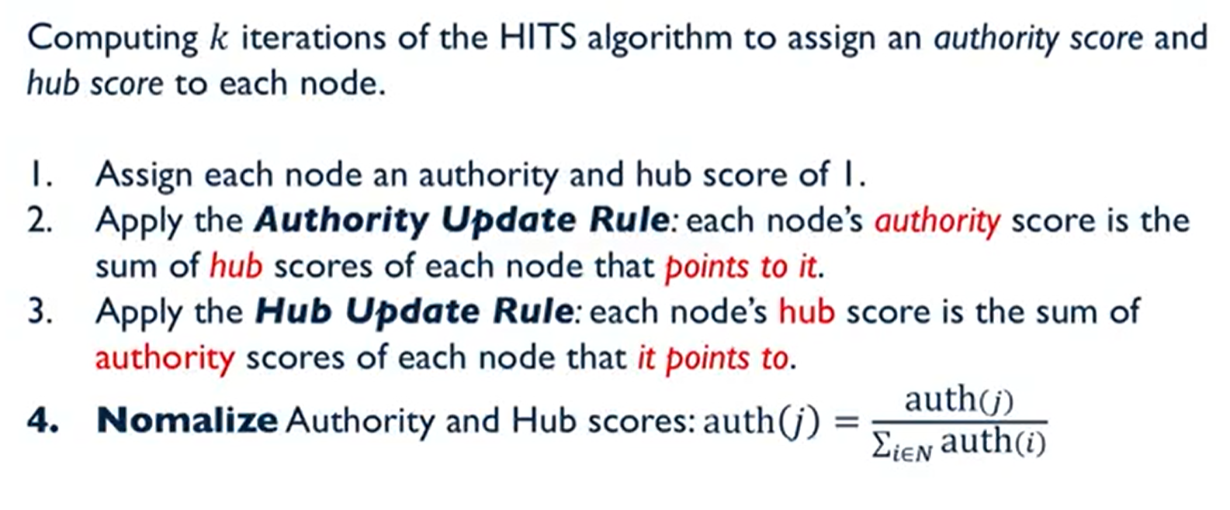
Hubs & Authorities

Slide 7
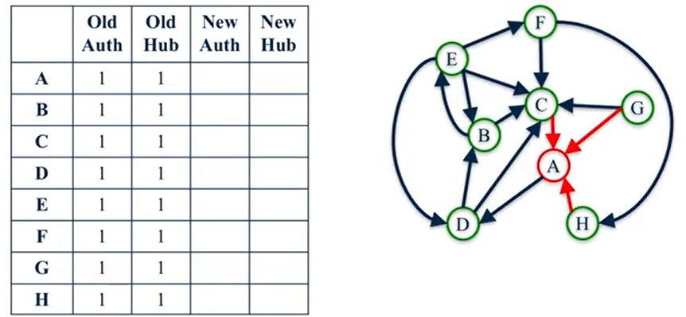
Example - HITS

Slide 8
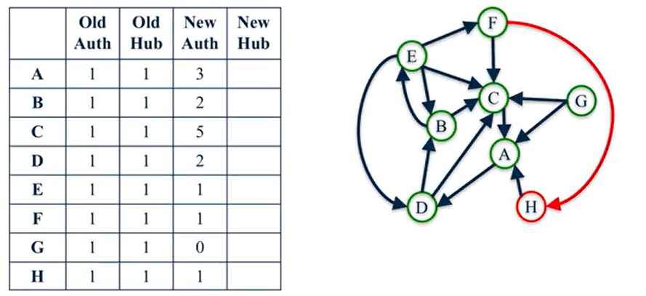
Example - HITS

Slide 9
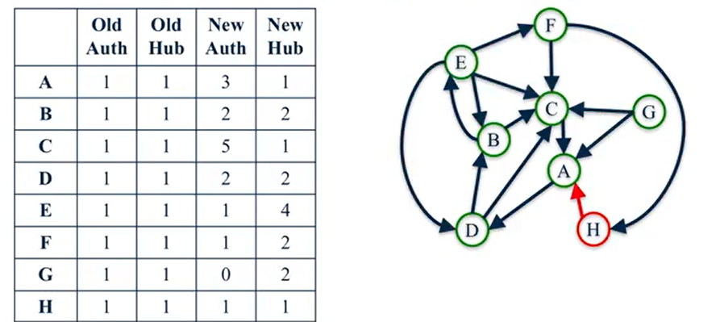
Example - HITS

Slide 10
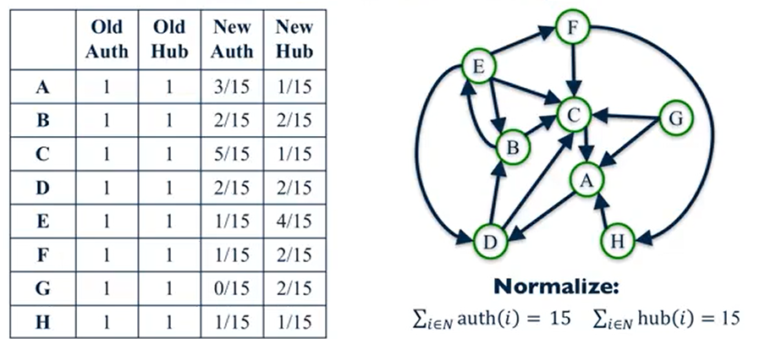
Example - HITS

Slide 11
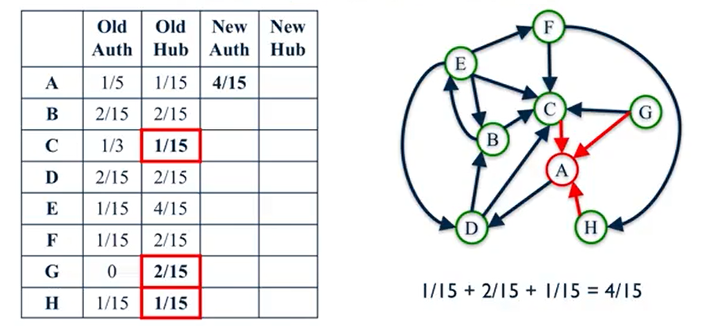
Example - HITS

Slide 12
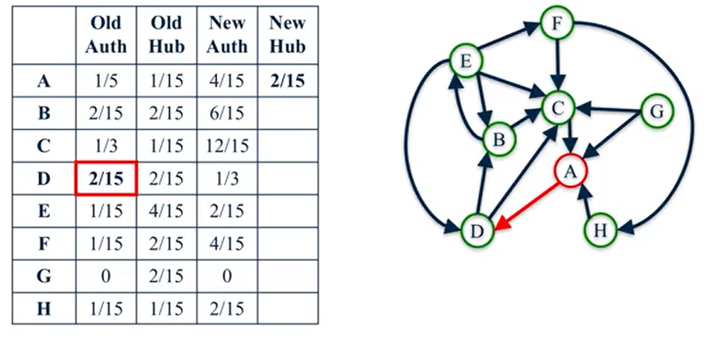
Example - HITS

Slide 13
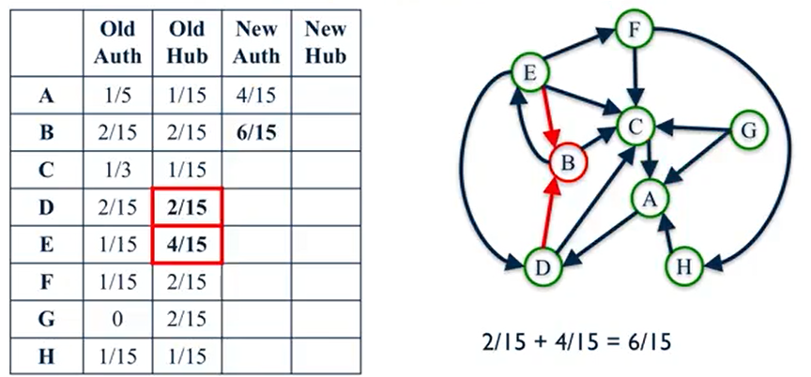
Example - HITS

Slide 14
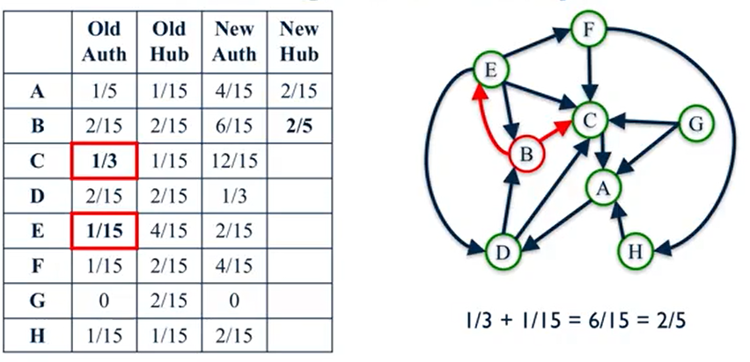
Example - HITS

Slide 15
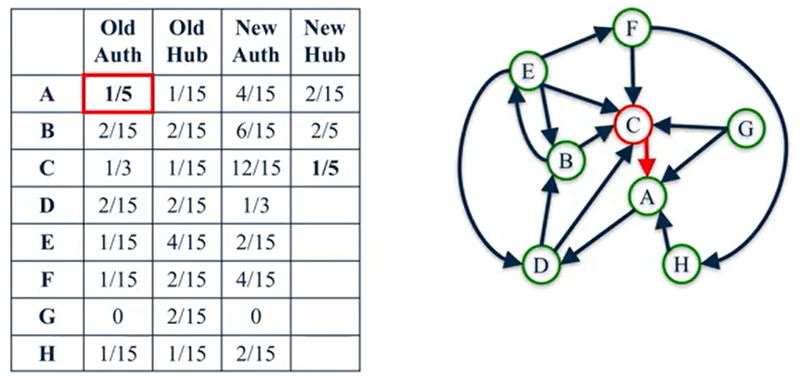
Example - HITS

Slide 16
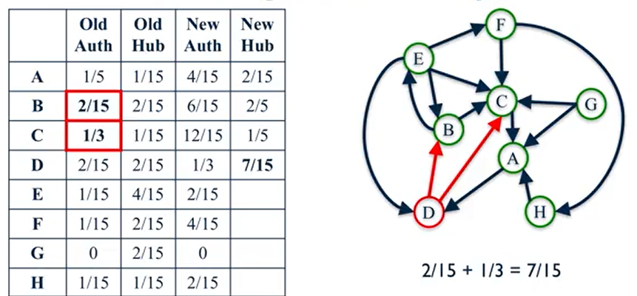
Example - HITS

Slide 17
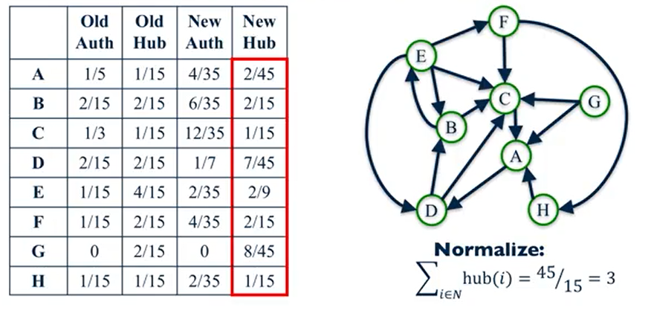
Example - HITS

Slide 18
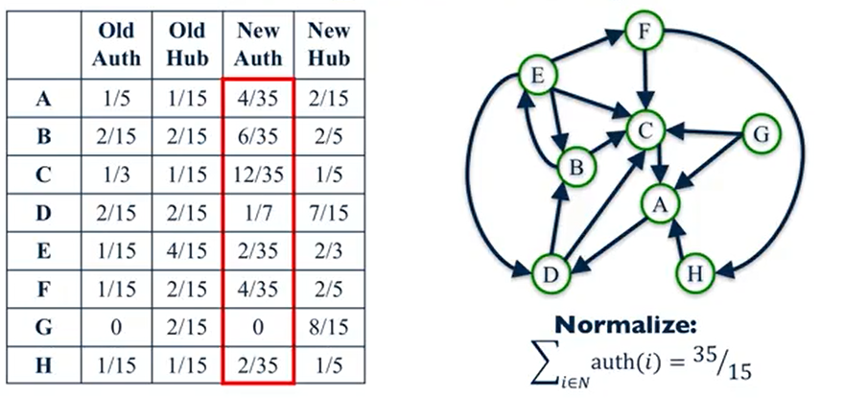
Example - HITS

Slide 19
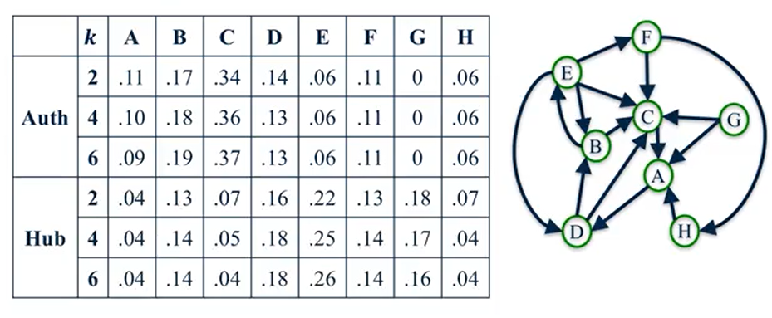
Example - HITS

Slide 20
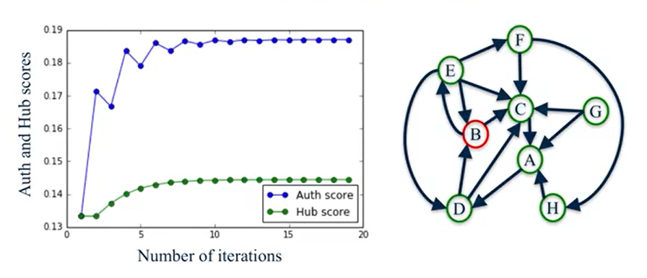
HITS Convergence

Slide 21
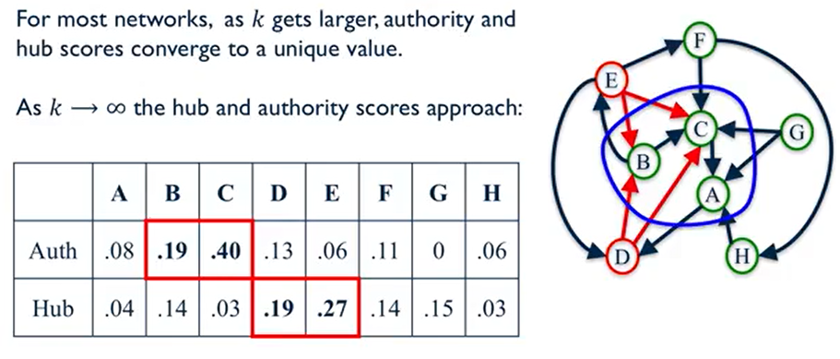
HITS Convergence

Slide 22
Hubs & Authorities
Assemble the target subset of web pages, form the graph induced by their hyperlinks
Compute AA^{T} and A^{T}A
Compute the principal eigenvectors of AA^{T} and A^{T}A to form the vector of hub scores h and authority scores a.
Output the top-scoring hubs and the top-scoring authorities

Slide 23
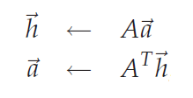
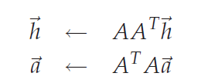
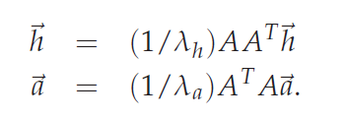
Hubs & Authorities
Matrix- vector form
λh - - eigenvalue of AAT
λa - eigenvalue of ATA

Slide 24
Authority value of a page = Sum of hub value of all the pages pointing to it
Hub score of a page = Sum of authority values of all the pages it points to

Slide 25
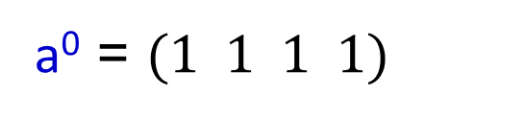
A
B
h⁰ = (1 1 1 1)
a⁰ = $(1 1 1 1)$
D
C
h¹(A)= a⁰(B) + a⁰(C) + a⁰(D) = 3
h¹(B)= a⁰(C) + a⁰(D) =1+1 = 2
hub = (3/8 2/8 1/8 2/8 )
h¹(C)= a⁰(B) =1
h¹(D)= a⁰(A) + a⁰(C) =1+1 = 2

Slide 26
A
B
h⁰ = (1 1 1 1)
D
C
a⁰ = (1 1 1 1)
authority= (1/8 2/8 3/8 2/8)
a¹(A)= h⁰(D) = 1
a¹(B)= h⁰(A) + h⁰(C) =1+1 = 2
a¹(C)= h⁰(A) + h⁰(B) +h⁰(D) =1+1+1=3
a¹(D)= h⁰(A) + h⁰(B) =1+1 = 2

Slide 27
h¹ = (3/8 2/8 1/8 2/8 )
A
B
a¹ = (1/8 2/8 3/8 2/8)
D
C
h²(A)= a¹(B) + a¹(C) + a¹(D) =2+3+2 = 7/8
h²(B)= a¹(C) + a¹(D) =3+2 = 5/8
h²(C)= a¹(B) =2/8
h²(D)= a¹(A) + a¹(C) =1+3 = 4/8
h² = ( 53/32, 45/32, 18,32, 36/32)

Slide 28
A
B
h¹ = (3/8 2/8 1/8 2/8 )
a¹ = (1/8 2/8 3/8 2/8)
D
C
a²(A)= h¹(D) = 2/8
a²(B)= h¹(A) + h¹(C) =1/8*(3+1) = 4/8
a²(C)= h¹(A) + h¹(B) +h¹(D) =1/8*(3+2+2)=7/8
a²(D)= h¹(A) + h¹(B) =1/8*(3+2) = 5/8
a² = (18/32 36/32 53/32 45/32)

Slide 29
A
B
A B C D
A 0 1 1 1
B 0 0 1 1
C 0 1 0 0
D 1 0 1 0
D
C
h⁰ = (1 1 1 1)
a⁰ = (1 1 1 1)
h = A * a
A B C D
A 0 1 1 1
B 0 0 1 1
C 0 1 0 0
D 1 0 1 0
1
1
1
1
3
2
1
2
3/8
2/8
1/8
2/8
h¹ = A * a⁰
=

Slide 30
a¹ = A^{T} * h⁰
A B C D
A 0 0 0 1
B 1 0 1 0
C 1 1 0 1
D 1 1 0 0
1
1
1
1
1
2
3
2
1/8
2/8
3/8
2/8
=

Slide 31
A B C D
A 0 1 1 1
B 0 0 1 1
C 0 1 0 0
D 1 0 1 0
1/8
2/8
3/8
2/8
7/8
5/8
2/8
4/8
h² = A * a¹
=
a² = A^{T} * h¹
A B C D
A 0 0 0 1
B 1 0 1 0
C 1 1 0 1
D 1 1 0 0
3/8
2/8
1/8
2/8
2/8
4/8
7/8
5/8
=

